Slide 1

Multi-Employer Benefit Plan Council of Canada Annual General Meeting
Haripaul Pannu, Deputy Superintendent of Pensions
May 8, 2026

Slide 2
Employment Pensions
Our role in the Supervision of Pensions in Alberta

Slide 3
Employment Pensions: Branch Mandate
Mission Statement
To provide a fair and balanced regulatory environment that supports the development and maintenance of strong and stable pension plans and protects individuals’ pension rights.
Role
Responsible for the regulatory oversight of pension plans registered under the Employment Pension Plans Act (EPPA).

Slide 4
Alberta Pension Profile – December 31, 2024
 | Plans | Members | Assets (in billions)
Defined Benefit
- Jointly Governed | 3 | 422,600 | $ 96.5
- CBMEP | 20 | 179,700 | 17.2
- Single Employer / Other | 129 | 174,700 | 47.6
Sub total | 152 | 777,100 | $161.3
Defined Contribution | 417 | 223,900 | $ 9.3
Total | 569 | 1,001,000 | $170.5

Slide 5
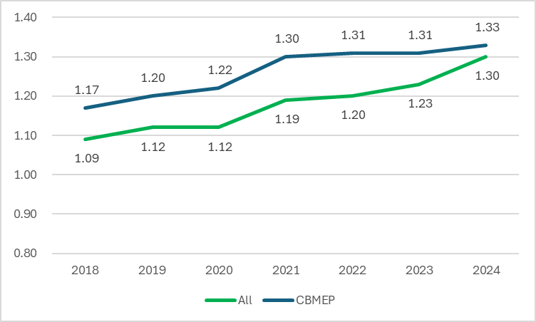
Alberta Pension Landscape – Funding Levels

Slide 6
Legislative Changes
Notes:
We’re going to spend some time on fiduciary duty, and I recognize that for many trustees this may feel like familiar territory, especially those with extensive board experience. But our interviews revealed that while most of you can articulate the concept at a high level, the application in specific decision-making contexts — particularly the TPA decision — was inconsistent. So rather than treating this as a refresher, I’d encourage you to listen for the specific ways these principles should have shown up in your recent process, and whether they did.

Slide 7
Retroactive Conversion of Pension Plans from Defined Benefit to Target Benefit
History
When the EPPA was updated in 2014, we received legal advice that there was a risk if we permitted the conversion of accrued defined benefits into target benefit for past service.
British Columbia fixed this issue before their Act was introduced.
Alberta has allowed plans to fund on a target benefit basis under a temporary regulation, until the Act could be amended.

Slide 8

Bill 17
What's Changing
Effective Dates
Key Reform: Retroactive DB → Target Benefit Conversion
Amendments to the Employment Pension Plans Act (EPPA) form part of the broader Fiscal Measures Statute Amendment Act introduced under Bill 17.
Some provisions take effect upon royal assent. Others require further regulation amendments, expected in Fall 2025.
Current law limits target benefit funding to go-forward service only. EPPA changes remove this restriction, allowing entire plans, including accrued past service, to operate under a single, consistent framework.
Fixed-Contribution Reality: Aligns the law with how CBMEPs have operated for decades
Legal Certainty: Replaces temporary regulatory exemptions with a permanent legislative solution
Precedent: British Columbia has already addressed this gap
Alberta CBMEPs have been granted a regulatory exemption allowing them to fund on a target benefit basis. EPPA changes make this arrangement permanent and legally certain.

Slide 9
Retroactive Conversion of Pension Plans from DB to TB
The legislative changes grant multi-employer negotiated cost plans (i.e., CBMEPs) the legal permission to convert their entire plan, both past and future service, into a single target benefit structure:
1
2
3
Benefit Reduction
Conversion Power
Protections / Limitations
Anticipated Update: Amends the general power to reduce benefits to specify accrued benefits, subject to new conversion rules.
Anticipated Update: Explicitly allows multi-employer negotiated cost plans to convert DB provisions to TB provisions, including past service.
Conversion is limited to negotiated cost plans.
Notes:
Here, we will transition from the "why" to the "what“, and I’ll outline the specific powers granted by the EPPA changes in Bill 17 (part of a larger Fiscal Measures Statutes Amendment Act) Clarifying Benefit Reductions: Legislation will update general powers to specify that accrued benefits can be reduced, provided they follow the new conversion rules. Expanded Conversion Power: CBMEPs will have legal permission to convert their entire plan—including past service—into a single TB structure.
Strict Scope: These powers are not universal; they are strictly limited to negotiated cost plans.
Alberta is essentially following in the footsteps of British Columbia, which addressed these considerations before introducing their own Act several years ago.

Slide 10
Eligibility: Reintroducing Hours-Based Participation
Eligibility Changes
Operational Benefits
An hours-based membership criterion would offer an alternative to the existing earnings-based criterion.
Under this new proposal, members could become eligible after 2 consecutive years of employment, with a minimum of 350 hours worked in each of those 2 fiscal years, if supported by the plan text.
The current earnings standard (35% YMPE) will remain as an option for eligibility.
Administrative Simplicity
Hour-tracking data is often already available, simplifying the eligibility assessment process.
Sector Alignment
Better suited for industries like construction and trades, where earnings can fluctuate significantly.
Red Tape Reduction
Reintroduces a practical standard from the pre-2014 era, streamlining compliance.
Notes:
Now, moving away from funding structures and into the second major change around membership eligibility. It’s a "back to the future" move, reintroducing a practical standard from the pre-2014 era.
The New (Old) Standard: Members can become eligible after two consecutive years of employment if they work at least 350 hours in each year.
Choice and Flexibility: Crucially, the current 35% of YMPE (Year’s Maximum Pensionable Earnings) earnings-based standard isn't going away—it remains an option for plans that prefer it.
Sector-Specific Benefits: This is a win for industries where earnings can fluctuate significantly, but hours-worked data is usually already tracked and available.
Red Tape Reduction: It’s also a common-sense update that simplifies administration and streamlines compliance for plan sponsors.

Slide 11
Regulatory Updates
June 2024, amended the definition of PfAD to 7.5% plus a supplementary percentage
17 plans have filed an actuarial valuation report under the new basis
September 2025 released a Fact Sheet on Pension Plan Registered in Alberta
October 2025, the Superintendent of Pensions removed the Board of Trustees of the ACAW Pension Plan and replaced them with a temporary administrator
Notes:
Previous pfad volatile, went from average of 25% in 2019 to 32% in 2020, 25% in 2021, 15 % in 2022 to 16% in 2023
New pfad 7.5% plus a supplementary percentage. As of reporting for the end of last year 17 of 20 plans have filed a valuation under the new methodology and the average supplementary percent was 5.4%

Slide 12
Regulatory Updates
December 2025, the office conducted a review of the governance and expenses of the top 8 CBMEPs.
March 2026, amendments to the EPPA
June 2026 anticipated meeting with Superintendent’s CBMEP Advisory Committee
Fall 2026, anticipated amendments to EPPA and EPPR
Notes:
CBMEPAC receive feedback on process to convert to TB
Should administrator consent be required for conversion?
Are there any other procedural requirements that should be considered for conversion? (e.g. should a vote be required

Slide 13

Questions?

