Slide 1
2026 Ontario Budget:
Insurance Premium Tax Update
Roberto Tomassini
Partner
(416) 595-2116
rtomassini@kmlaw.ca

Slide 2
Overview
Reasons for current focus on IPT
What is IPT?
Lobbying efforts
Changes proposed in Ontario Budget 2026

Slide 3
Why are we talking about IPT?
Current focus on IPT in Ontario originally arose from Ministry of Finance (“MOF”) audits
All Ontario ELHTs have been potential targets
IPT regime had many compliance hurdles, incl.:
  Unclear legislation
  Inconsistent audit activity
  Inability to coordinate with insurers (compare to RST regime)

Slide 4
Current focus (continued)
Once MOF’s intention to target all ELHTs for audit, many ELHTs with compliance concerns filed “voluntary disclosures” (“VDs”)
VD are a method for self-disclosing non-compliance
Under Ontario’s VD policy, penalty relief is generally provided when a VD is accepted, but not interest

Slide 5
How is IPT calculated?
Tax base depends on trust classification under the CTA
  “Funded Benefit Plan” – contributions exceed amount required payment of benefits foreseeable and payable within 30 days
  “Unfunded Benefit Plan” – benefit plan that is not a funded benefit plan
  Funded Benefit Plan – 2% applicable on contributions
  Unfunded Benefit Plan – 2% payable on benefits
  “Qualifying Trust” – 2% payable on benefits

Slide 6
What is IPT ?(continued)
In Ontario, IPT is a 2% tax that generally applies to all contributions to an ELHT (incl. member contributions)
There are carve outs for contributions that pay for:
  Taxable benefits (STD, Life Insurance, AD&D)
  Benefits for members living outside Ontario
  Benefits for members with “status” under the Indian Act who live on Reserve

Slide 7
What is this tax? (continued)
Different from the 2% tax that applies to premiums paid to third party insurers
However, MOF accepts that an offset is appropriate (reconciled after year-end)
Tax applies here AND here
Employers
Contributions
ELHT
Insurance Premiums
Insurer
Members

Slide 8
Lobbying efforts
MEBCO along with a number of Unions and MEPs lobbied the Ontario Government seeking relief from penalties, interest, and arrears as well as rule changes.
MEBCO made a submission to the 2026 Pre-Budget Consultations requesting:
  An exemption from IPT for group benefit funds
  In the alternative, treat all benefit funds as “unfunded benefit plans”
  Waive all interest and penalties
✗
✓
?

Slide 9
Budget Measures Act, Bill 97
Released March 26, proclaimed April 24
Allows funded benefit plans to elect to be treated as an unfunded benefit plans
Election allows premium tax to apply to benefit payments and admin fees, not contributions
  In practice* this is generally easier to administer
  It often also results in a lower IPT burden
  * For trusts established before 2010, when IPT is imposed on benefits, employers and members are generally liable for IPT, but unless the CBA or plan requires it, the trust is on the hook for the IPT

Slide 10
Budget Measures Act, Bill 97
Based on the Budget Docs, funds will be able to make the election retroactive to April 1, 2026
No details yet on the form and manner of the election or whether there will be a deadline to elect for a given year
Amended legislation states the Minister “may” prescribe regulations that limit the type of funded benefit plans that may make the election and the time period that the election may be effective
The Minister is also expected to prescribe regulations governing the application of tax when a fund transitions from funded to unfunded

Slide 11
Interest and penalties
Based on various conversations with Government officials, MEBCO’s understanding is that the Government intends to waive all penalties and (maybe) interest on IPT audits and VDs
However, MEBCO is not aware of a written policy statement to this effect
We are aware of interest relief being provided in a number of VDs
If your ELHT is being hit with interest or penalties in a recent audit or VD review, consider reaching out to your legal counsel for support

Slide 12
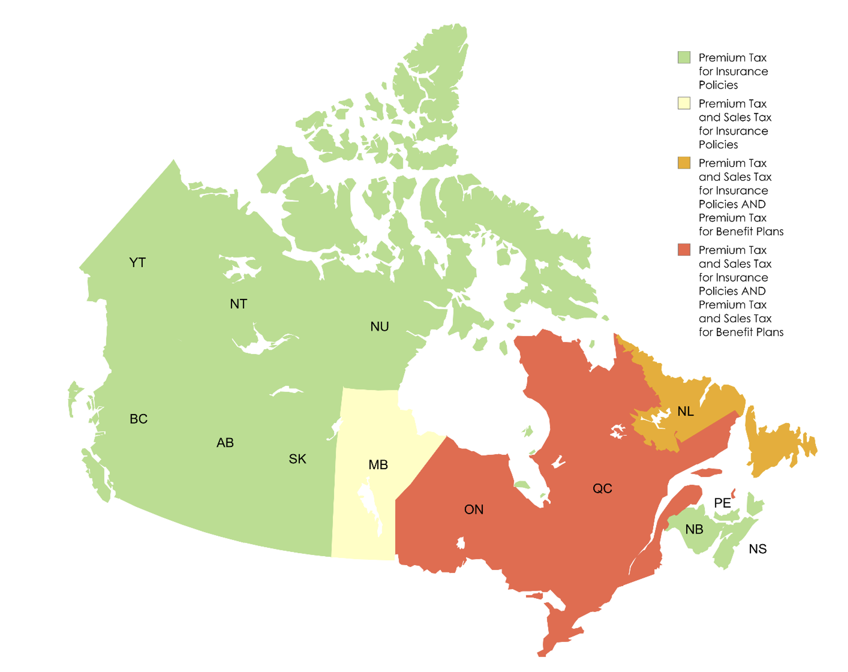
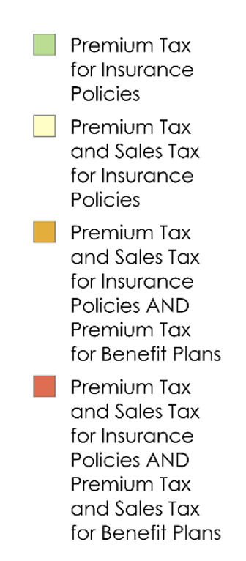
Rules in other jurisdictions

Slide 13
Questions?

